Slide 1

Compare and Contrast the Roles of a Data Engineer and a Data Analyst

Slide 2
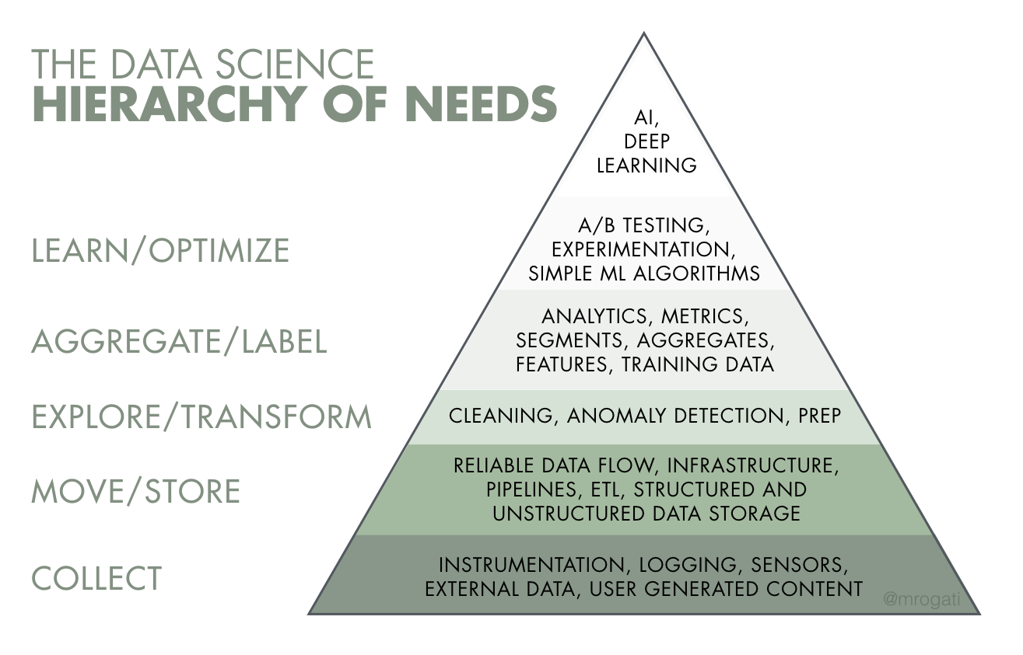
Firstly, I would like to talk about the full hierarchy of data science. There are many stages involved in making data usable and utilising that data for an organisation. Firstly, algorithms must be designed to collect and log data… Secondly, it is necessary to write data pipelines in order to move data from one place to another, often this data may be flawed so it is important to always be cleaning this data in order to ensure it is useable and quierable. If both these steps have been completed properly it will be possible for anyone within the company to query the data, to ask for example “how many people have used my new feature in the last week”.The next step is to use this data to make business decisions and insights, there are a number of useful tools for this step such as A/B testing and simple machine learning algorithms. There is loads of useful information that can be uncovered at this stage. If, however, these simpler tests are not enough then AI and deep learning can be used to fully empower the decision making process. So where does each job come into the hierarchy?

Slide 3
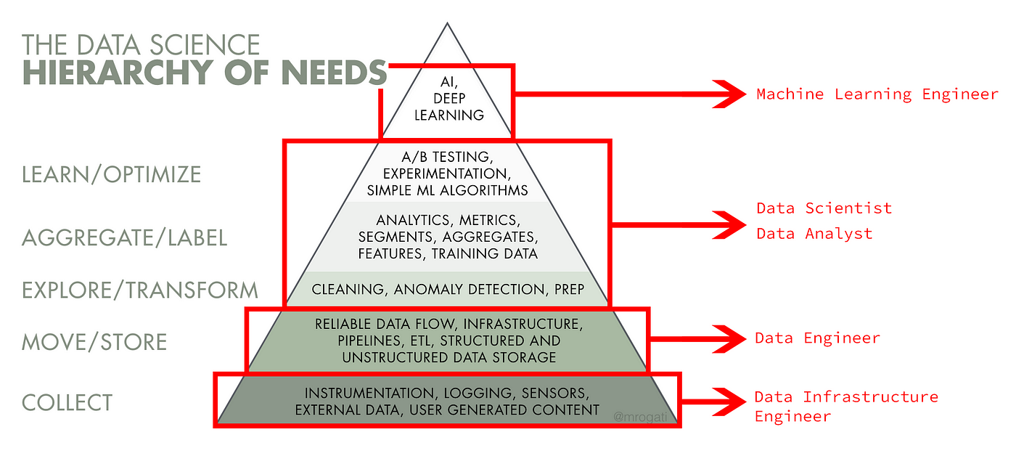
A data infrastructure engineer collects the data
A data engineer moves, stores and cleans the data
A data analyst makes business insights based on the data
A data scientist builds simple machine learning algorithms and A/B tests for the purpose of business analysis
A machine learning engineer works with AI and builds deep learning algorithms to analyse data

Slide 4
What does a data engineer do more specifically?
A data engineer main role is to transform raw data into formats that are easily accessible for the data analyst who may not be an expert in querying raw data.
Moving/storing data:
In order to do this data engineers must
Work with structured and unstructured data
Structured data is highly detailed, organized and formatted whereas unstructured data does not have a predefined data models. Examples of unstructured data include images, audio and video.
Build relational and non relational databases
Relational databases store information into tables with columns, rows and fields. Often these tables have shared information between them causing relationships to form. Non relational databases are any kind of database that doesn’t use tables, columns and fields. So usually when we talk about databases we are referring to relational ones.
So what’s the difference between a
Building data pipelines
- a data pipeline is a method in which raw data is ingested from a number of sources and ported to a data store, such as a data warehouse or a data lake.
In order to build different pipelines it’s important to know the differences between different data stores.
The main differences involve how data is uploaded to each one and how each data store can be processed afterwards.

Slide 5
Relational databases
Captures and records data via an Online transactional process (OLTP)
Data is highly detailed
Flexible schema which means the information within a relational database can be changed easily

Slide 6
Data warehouse
Is also a relational database but it is
Designed for analytical processing (OLAP)
Data is uploaded from relational databases to a data warehouse using an ETL process, which stands for extracts, transforms and loads
Data is summarised, allowing us to process data much faster
Rigid schema, meaning it is more difficult to change the data in the data warehouse

Slide 7
Key differences
Databases are designed for transactions, data warehouses are designed for analytics and reporting
Databases are fresh and detailed, Data warehouses are refreshed periodically and are summarised
Querying databases works slowly and interferes with transactional processes, Data warehouses are faster and don’t interfere with processes

Slide 8
Data Lake
Is a database
Designed to capture raw data such as a video, a picture, an image, a document, a graph or anything you could imagine can be stored in a data lake
Benefits ML and AI the most as they can create models to utilise the data in its raw form
Can be organised and put into databases and data warehouses

Slide 9
When to use each one
If you just need to record transactions then a database is what you should use
If you have a huge amount of data that is too much for your systems to handle then you should use a data warehouse
If you have a huge amount of unstructured data that you can’t fit into a database then you should use a data lake
Data engineers spend a lot of time working with these data stores and building different pipelines to transform data into these more useable formats.

Slide 10
What does a data engineer do?
Builds pipelines to fill databases, data warehouses and data lakes
These data stores are designed to be easily accessible for a data analyst
May need to clean data, data in a data warehouse is already cleaned through the ETL process however data in a relational database may need to be cleaned. Data cleaning is the process of fixing or removing incomplete, corrupted, incorrectly formatted, duplicate or in complete data.

